Slide 1


Fundamentals of Risk Management
RM System, Process, & Program
Incident Investigation & Analysis
RM Tools & Challenges
People & Organizations
RM as Applied in Industry
Leadership in RM
Applications & Perspectives
On Becoming a
Leader in Risk Management
ENGG404 - Lecture
Chapter 6.6 An Introduction
to Occupational Health

Slide 2
Learning Outcomes:
Explain the relationship between health & safety in the workplace
Explain the importance of understanding health related risks & the role of leadership to address them
Explain the key concepts of occupational health
Explain the order of preference in controlling workplace exposures
Describe the engineering leadership role in supporting a Health Plan
Explain the role of leadership in a Workplace Health Surveillance Program
Chapter 6.6 An Introduction to Occupational Health
2
Notes:
2

Slide 3
Introduction:
Safety and health - closely related but not the same!
Occupational Safety:
Injury-causing situations
Acute, sudden, severe
Can also be chronic, long-term on-set, severe
Can include ergonomics
Occupational Health:
AKA industrial hygiene
Disease-causing conditions
Adverse reaction to prolonged exposure to hazardous substances
Usually chronic, long-term on-set, severe
The difference is not always clear; consider “Stress” as the hazard:
Psychological & physiological problems over a prolonged period.
Health concern.
However, a stressed worker may be more prone to rush or unintentionally forget or overlook safety precautions & thus lead to an incident.
Safety concern.
We are responsible for both, so we need to have an appreciation of both.
Chapter 6.6 An Introduction to Occupational Health
3
Notes:
3

Slide 4
Uranium and Mining:
Canada is the world's SECOND largest producer & exporter of uranium.
Uranium - naturally-occurring radioactive material (NORM) that is mined.
Commercial uses for uranium: weapons & reactors (energy, medicine, engineering diagnostic tools, food sterilization)
Medical science 1930’s: airborne radioactivity likely causes lung cancer: mining releases radon gas (odourless, colourless, inert, half-life = 3.8 days.
Key to disease prevention – control the mine atmosphere:
Control dust and improve ventilation
Inadequate ventilation can cause contamination with dust and radon “daughters” – radiation dose right inside the lungs
There is no such thing as a "safe dose" of radiation although we live with and are immersed in background radiation
The higher incidence of lung cancer may take years to occur.
Occupational health issue!
Prolonged exposure leads to disease years and decades later!
Chapter 6.6 An Introduction to Occupational Health
4
Notes:
4

Slide 5

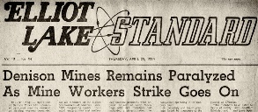
Uranium and the Elliot Lake Tragedy:
1973: “… an increasing number of miners in Elliot Lake who are starting to show the effects of dust in their lungs. When we consider that there is also radiation exposure involved, this could lead to a very dangerous situation”.
In response, Rio Tinto VP: “Menace of dust exposure in these uranium mines we believe is not yet generally understood” & “take some time before all its particular hazards are fully recognized”
Annual x-rays & medical examinations of workers; results not disclosed.
Paris Conference on uranium mining
attended by mine union members and provincial government officials; officials spoke about the harmful effects of radiation based on studies of Elliot Lake miners.
1974 – Elliot Lake Uranium miners
at Denison Mines wildcat strike
to protest unhealthy working
conditions.
Chapter 6.6 An Introduction to Occupational Health
5
Notes:
5

Slide 6
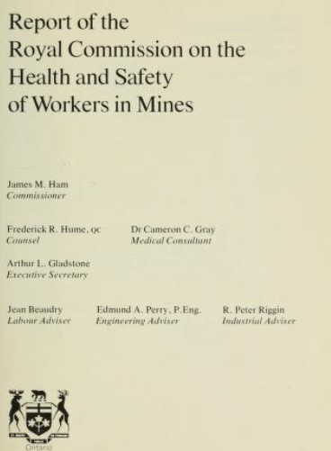
Uranium, Elliot Lake, & Ham Report Excerpts & Leadership:
The “Ham Report”:
Ontario government established the Royal
Commission the Health and Safety of Workers
in Mines (the Ham Commission 1976-June-30).
https://archive.org/details/reportofroyworkmine00onta/page/n3/mode/2up
The Ham Report criticized government & mining
companies for lacking transparency and failing to
protect 30,000 Ontario mine workers from
hazardous conditions.
Report had 117 recommendations with implications beyond Ontario.
Key outcome – Internal Responsibility System (IRS) for OHS
  Underlying philosophy of the OHS legislation in all Canadian jurisdictions: everyone in the workplace - both employees and employers - is responsible for his or her own safety and for the safety of co-workers
Chapter 6.6 An Introduction to Occupational Health
6
Notes:
6

Slide 7
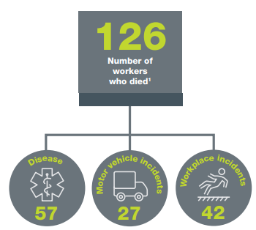
The Alberta Context:
Alberta Occupational Health and Safety Act - Excerpts:
Employers must ensure that worker exposure to a harmful substance is kept as low as reasonably practicable / reasonably achievable and does not exceed the substance’s Occupational Exposure Limit (OEL: simply, the concentration under which exposure is generally believed to not cause harm)
Specific requirements for asbestos, silica, coal dust or lead
Consequences of Exposure:
In 2018, 45% of Alberta work fatalities were
associated with an occupational disease.
Chapter 6.6 An Introduction to Occupational Health
7
Notes:
7

Slide 8
Occupational Health Hazards:
Three categories of OHH’s:
1) Chemical
sulphuric acid, H2S, coal dust
combination of concentration and duration of exposure
Any chemical has the potential to be a toxicant (a toxic substance)
2) Physical
noise; heat/cold stress; lighting; ergonomic factors
3) Biological
airborne-virus; animal-borne virus; animal-borne bacteria; sanitary waste; natural pathogens
combination of virulence of the micro-organism & extent of exposure.
Hazardous effects of OHH’s depend on three main factors:
Dose i.e. how much?
Time exposure i.e. how long, how often?
Exposure routes: how is the person exposed?
Typically, as concentration increases, time decreases.
Chapter 6.6 An Introduction to Occupational Health
8
Notes:
8

Slide 9
Definitions:
Many substances have toxic properties - we need to have a basic understanding of toxicology to use these substances safely:
Toxicology: the scientific discipline that involves studying the adverse effects of chemical substances on living organisms
Toxicant: any substance that is toxic, causing harm or is fatal to living organisms
Industrial Hygiene:
Concerned with environmental factors that can lead to sickness, disease, or other forms of impaired health
Prevent or reduce entry: biological agents, chemical agents, physical agents
Industrial Hygiene surveys of work environment have four parts
Anticipation – expectation of hazard existence
Identification – presence of workplace exposure
Evaluation – magnitude of exposure
Control – reduction to acceptable levels
Chapter 6.13 An Introduction to Occupational Health
9
Notes:
9

Slide 10
Exposure Routes for Toxicants:
Exposure to hazardous substances:
Inhalation of airborne gases, vapors or particulates
Ingestion of liquids or particulates
Skin absorption after contact with liquids
ROUTE | ENTRY | CONTROL
Inhalation* | Mouth, nose | Ventilation, fume hoods, respirators, face hoods, personal protective equipment
Dermal Absorption* | Skin | Protective clothing
Injection | Cuts or punctures in skin | Protective clothing
Ingestion | Mouth, stomach | Enforcement of rules on eating, drinking, smoking
 |  | * industrially most significant but can vary for different industries
Chapter 6.6 An Introduction to Occupational Health
Notes:
10

Slide 11
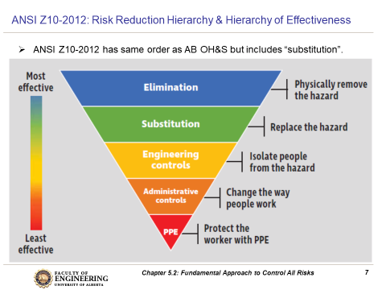
Exposure Control:
Order of preference for controlling exposure to health hazards:
Note: PPE a “last resort”
Chapter 6.6 An Introduction to Occupational Health
11
Notes:
11

Slide 12
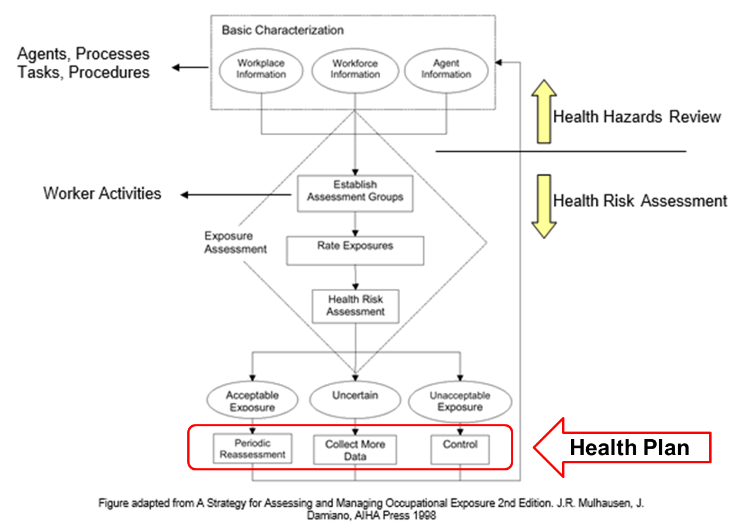
Health Exposure Methods:
Health Hazards Review and Health Risk Assessment::
Experts: Medical Scientists, Toxicologists, Epidemiologists, Industrial Hygienists
Identify hazards
Assess exposures to hazards and determine if acceptable or not
Health Plan:
Proactive organizations develop, implement, and maintain/update health plans to manage their occupational health exposures (risk)
The objectives of a health plan are to:
Prevent health incidents and adverse long-term exposures
Minimize the seriousness of injuries and illness / access to quality medical care
Integrate health control measures into facility engineering & design
What does the Health Plan do?
Periodic reassessment
Collect more data
Implement controls
As engineers (as leaders and designers),
what could be our role in supporting a Health
Plan within our facilities and operations?
Chapter 6.6 An Introduction to Occupational Health
12
Notes:
12

Slide 13
ALE #1: Supporting a Health Plan
Please confer and respond (MM-Poll):
Consider any kind of material(s) that would be handled or used or manufactured in your engineering discipline. As engineers (as leaders and designers), what could be our role in supporting a Health Plan?
Incorporate inherently safer design principles into our engineering work
Conduct an industrial hygiene survey when the facility is operational
Incorporate health considerations into the MOC process
Establish an electronic system to maintain safety data sheets on site
Incorporate health considerations into the scope of risk assessments
Chapter 6.6 An Introduction to Occupational Health
13
Notes:
13

Slide 14
Example: Supporting a Health Plan
We can support a Health Plan :
Incorporate inherently safer design principles into our engineering work
Conduct an industrial hygiene survey when the facility is operational
Incorporate health considerations into the MOC process
Establish an electronic system to maintain safety data sheets on site
Incorporate health considerations into the scope of risk assessments
Chapter 6.6 An Introduction to Occupational Health
14
Notes:
14

Slide 15
Workplace Health Surveillance Programs:
WHSP’s can be implemented:
As required per regulatory requirements
Voluntarily to inform management
Examples: hearing conservation, respiratory protection, medical surveillance guidelines for benzene chemical exposure
Key Objective of a WHSP:
Provide guidance to management for further investigation or action based upon the identification of trends suggesting a potential adverse health effect
Leadership role - support WHSP’s:
provide resources,
provide access,
be transparent,
take action to address issues.
Chapter 6.6 An Introduction to Occupational Health
15
Notes:
15

Slide 16
Summary:
The terms health & safety are related but there are important distinctions between them
Leadership understanding of health related risks associated with our activities is required for us to prevent and/or control these exposures
Like other workplaces hazards, we have an order of preference for addressing potential worker health exposures
We can use a Health Hazards Review and a Health Risk Assessment to define a health exposure assessment strategy
As engineers, we have a leadership role in supporting the development of a Health Plan
Organizations employ Workplace Health Surveillance Programs as part of their ongoing worker monitoring efforts; and require leadership support.
Chapter 6.6 An Introduction to Occupational Health
16
Notes:
16

Slide 17
Any questions?
Notes:
17

